Slide 1

6th Grade Accelerated Math
Unit 14, Lesson 4 Solving One-Step Equations in One Variable Using Addition and Subtraction Volume 2, pg. 354

Slide 2


Benchmark
MA.6.AR.2.2
Write and solve one-step equations in one variable within a mathematical or real-world context using addition and subtraction, where all terms and solutions are integers.
volume 2, pg. 354

Slide 3
Integrated Mathematical Thinking and Reasoning Standards
MA.K12.MTR.1.1 Actively participate in effortful learning both individually and collectively.
MA.K12.MTR.2.1 Demonstrate understanding by representing problems in multiple ways.
MA.K12.MTR.4.1 Engage in discussions that reflect on the mathematical thinking of self and others.
MA.K12.MTR.5.1 Use patterns and structure to help understand and connect mathematical concepts.
MA.K12.MTR.6.1 Assess the reasonableness of solutions.
volume 2, pg. 354

Slide 4

Learning Target
I can solve addition and subtraction one-step equations.
volume 2, pg. 354

Slide 5

Warm-Up
volume 2, pg. 355

Slide 6
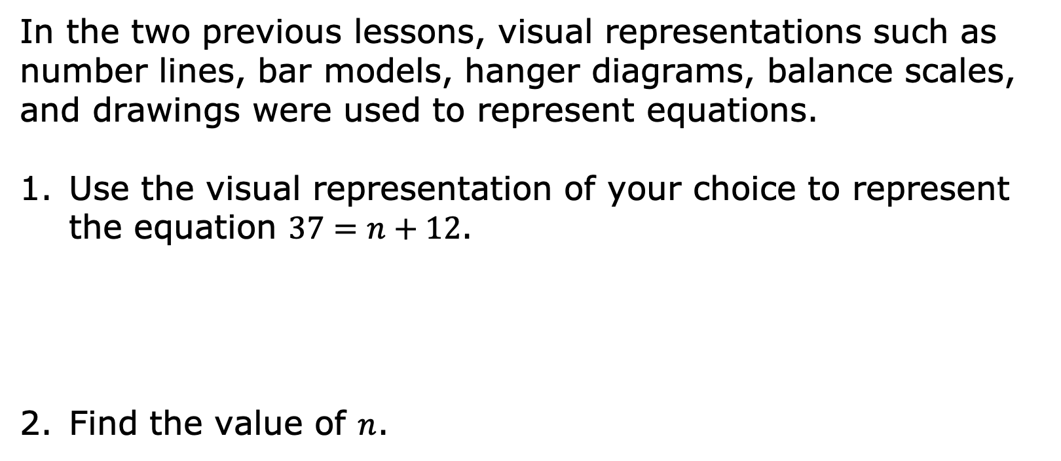
14.4.1 Warm-Up: Visualizing Solutions
In the two previous lessons, visual representations such as number lines, bar models, hanger diagrams, balance scales, and drawings were used to represent equations.
Use the visual representation of your choice to represent the equation $37=n+12$.
Find the value of $n$.
volume 2, pg. 355

Slide 7

Collaboration
volume 2, pg. 355

Slide 8

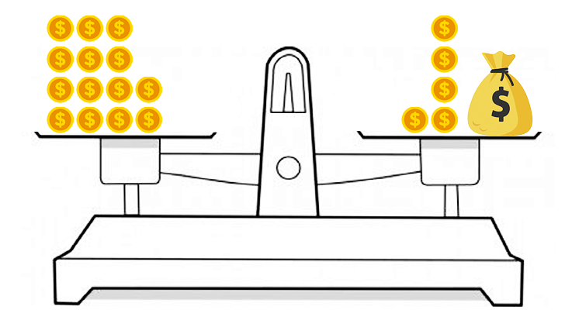
14.4.2 Collaboration: Algebraic Equations from a Diagram
Ellen and Frey were given the balance scale shown below, and told to write and solve an algebraic equation using inverse operations.
volume 2, pg. 355

Slide 9
Ellen said, “There’s no way to write an algebraic equation. If we can write an algebraic equation, we do not need inverse operations to solve it.”
Frey said, “The only way to solve an algebraic equation is to use inverse operations to show the math is being reversed.”
Whose statement do you agree with and why? Explain your answer to your partner.
volume 2, pg. 355

Slide 10
Write the algebraic equation represented by the balance scale.
Solve the equation and show the steps you took.
How many gold coins are in the bag? Compare your answer with your partner.
volume 2, pg. 356

Slide 11



A bar model is shown.
Write an addition equation and a subtraction equation that can be represented by the bar model.
$$y$$
$$3$$
$$21$$
Addition Equation | Subtraction Equation
volume 2, pg. 356

Slide 12
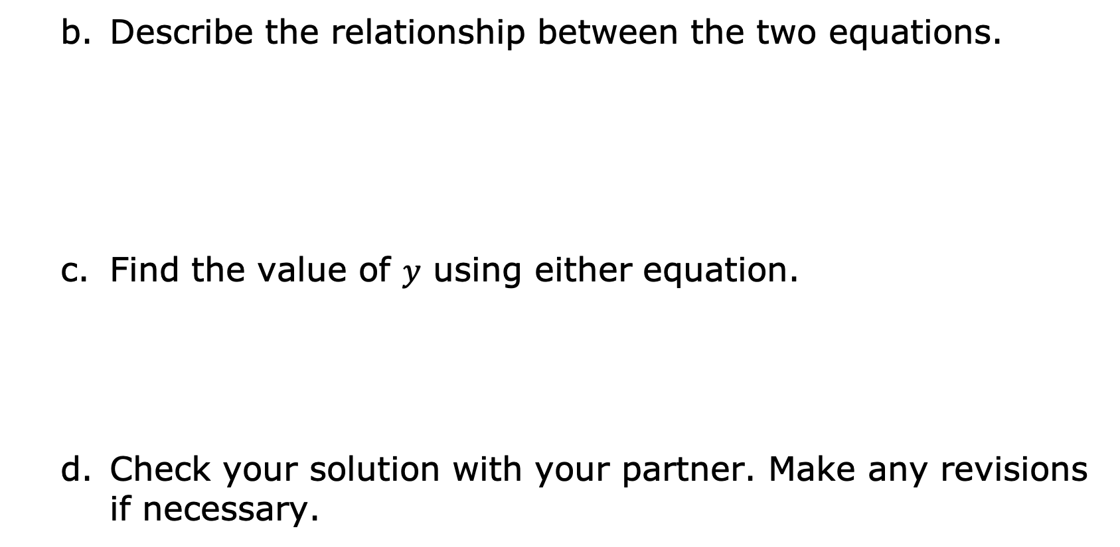
Describe the relationship between the two equations.
Find the value of $y$ using either equation.
Check your solution with your partner. Make any revisions if necessary.
volume 2, pg. 356

Slide 13

Guided Practice
volume 2, pg. 357

Slide 14

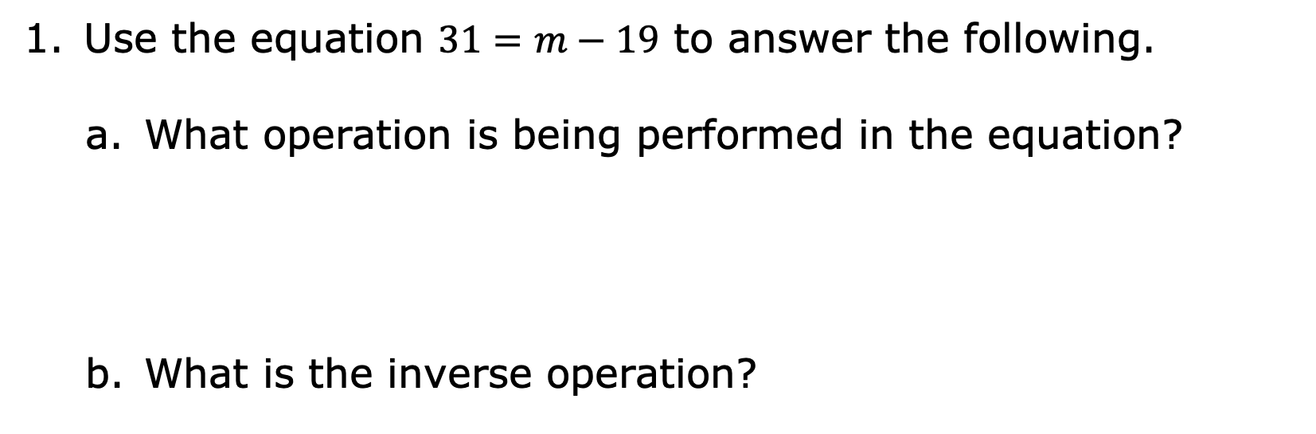
14.4.3 Guided Practice: Solving One-Step Algebraic Equations Using Inverse Operations
Use the equation $31=m−19$ to answer the following.
What operation is being performed in the equation?
What is the inverse operation?
volume 2, pg. 357

Slide 15
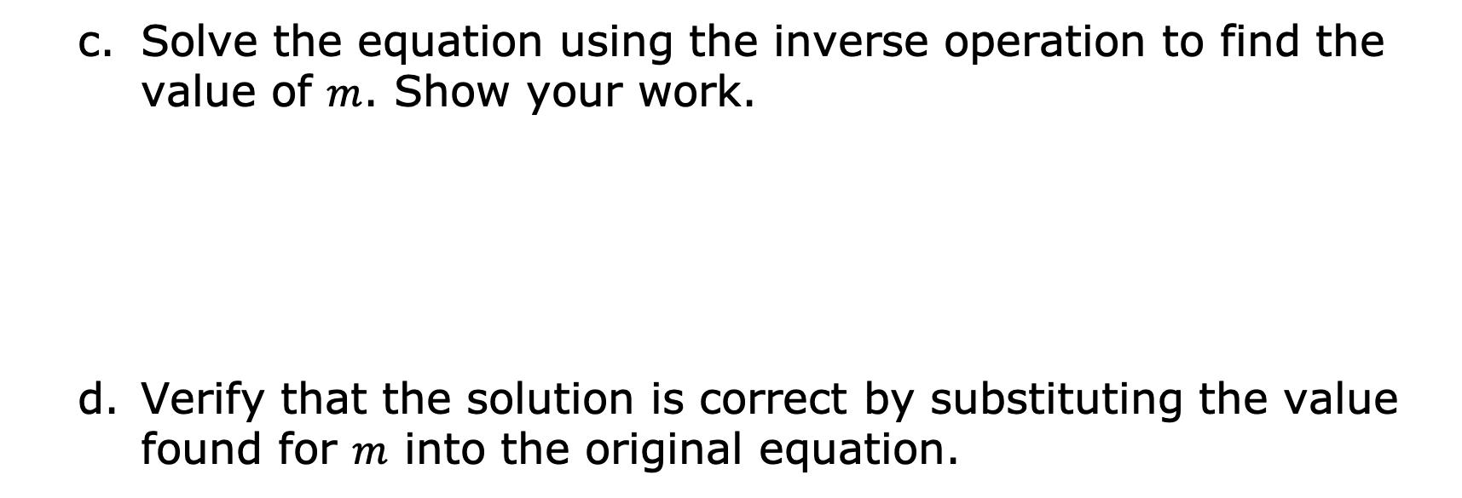
Solve the equation using the inverse operation to find the value of $m$. Show your work.
Verify that the solution is correct by substituting the value found for $m$ into the original equation.
volume 2, pg. 357

Slide 16
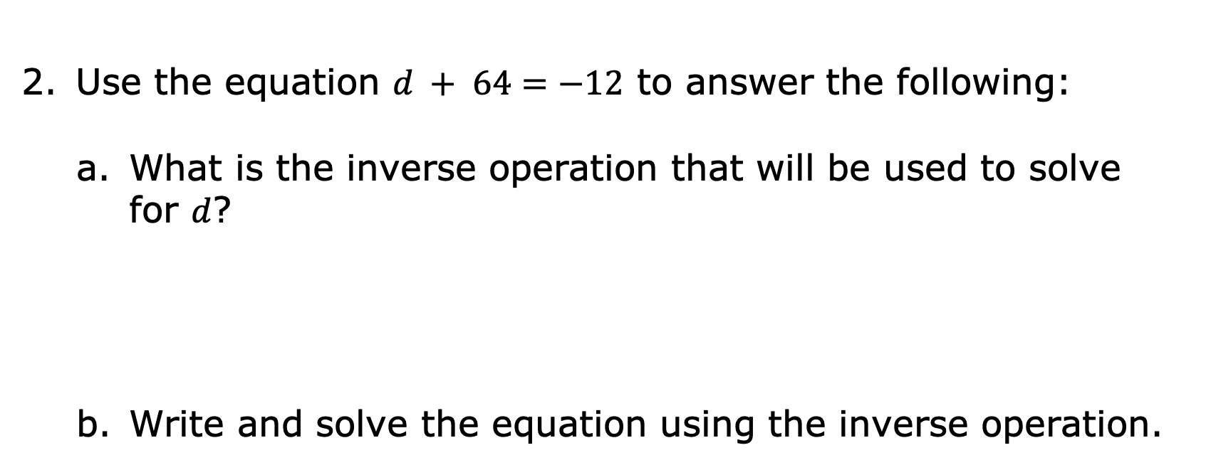
Use the equation $d + 64=−12$ to answer the following:
What is the inverse operation that will be used to solve for $d$?
Write and solve the equation using the inverse operation.
volume 2, pg. 357

Slide 17
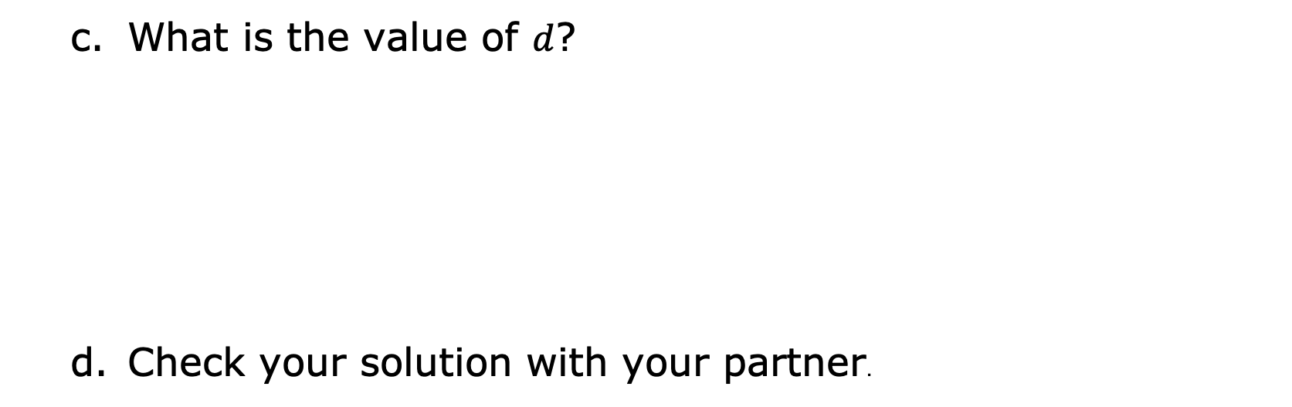
What is the value of $d$?
Check your solution with your partner.
volume 2, pg. 357

Slide 18

Exploration
volume 2, pg. 358

Slide 19

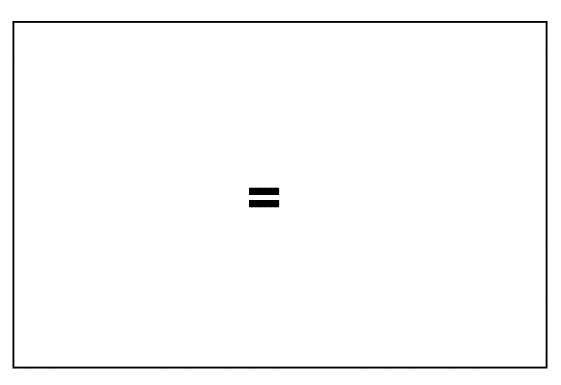



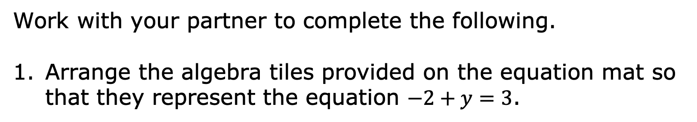
14.4.4 Exploration: Solving Equations Using Opposites
Work with your partner to complete the following.
Arrange the algebra tiles provided on the equation mat so that they represent the equation $−2+y=3$.
volume 2, pg. 358

Slide 20
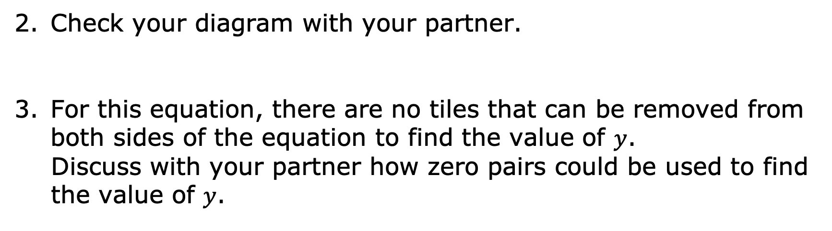
Check your diagram with your partner.
For this equation, there are no tiles that can be removed from both sides of the equation to find the value of $y$.
Discuss with your partner how zero pairs could be used to find the value of $y$.
volume 2, pg. 358

Slide 21
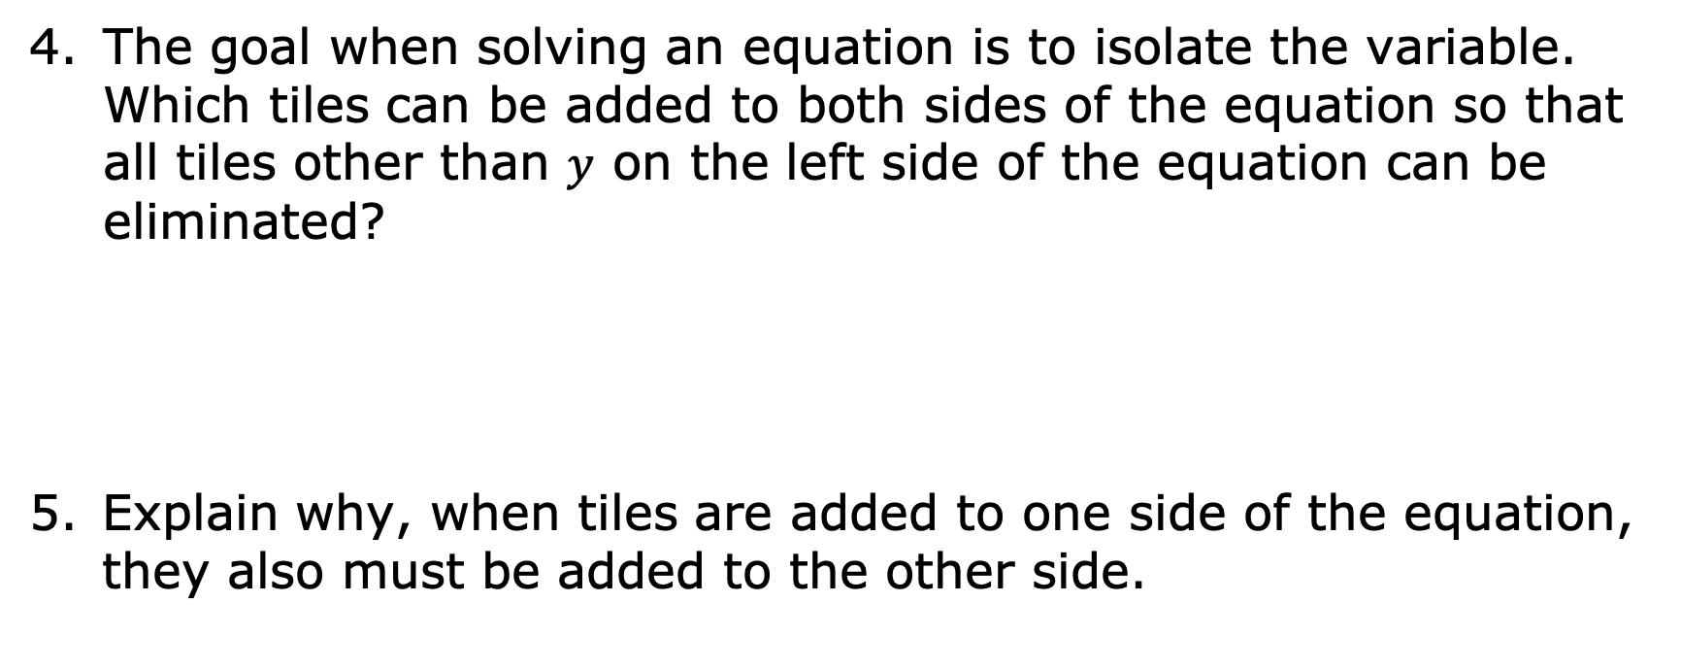
The goal when solving an equation is to isolate the variable. Which tiles can be added to both sides of the equation so that all tiles other than $y$ on the left side of the equation can be eliminated?
Explain why, when tiles are added to one side of the equation, they also must be added to the other side.
volume 2, pg. 358

Slide 22


Draw tiles on the equation mat to represent the solution to the equation.
volume 2, pg. 358

Slide 23
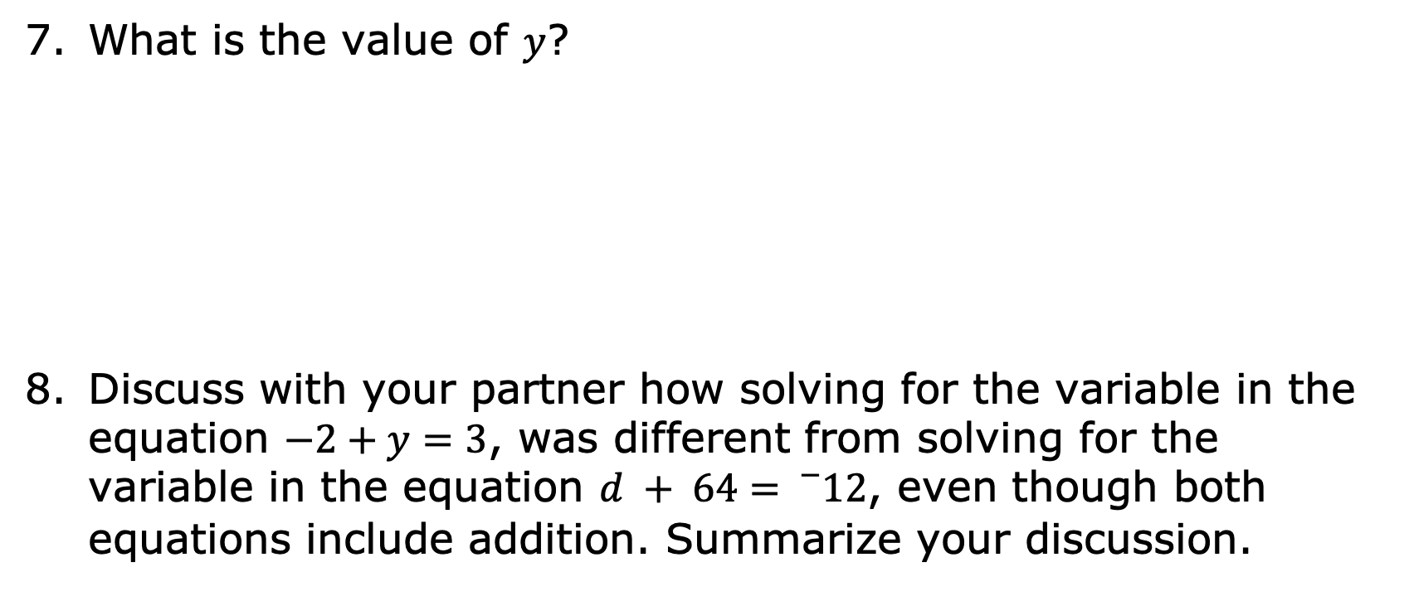
What is the value of $y$?
Discuss with your partner how solving for the variable in the equation $−2+y=3$, was different from solving for the variable in the equation $d + 64={}_{}^{−}{12}$, even though both equations include addition. Summarize your discussion.
volume 2, pg. 359

Slide 24
Collaboration
volume 2, pg. 359

Slide 25
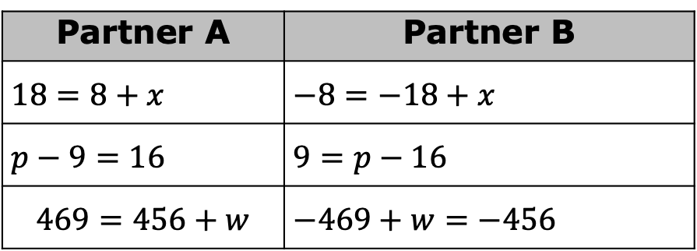
14.4.5 Collaboration: Solving Equations
With your partner, determine who will be Partner A and who will be Partner B.
Solve the equations from your designated column.
The equations in each row have the same solutions. Check your work with your partner, making revisions to your work if necessary.
Partner A | Partner B
$$18=8+x$$ | $$−8=−18+x$$
$$p−9=16$$ | $$9=p−16$$
$$469=456+w$$ | $$−469+w=−456$$
volume 2, pg. 359

Slide 26

Your Turn
volume 2, pg. 360

Slide 27

14.4.6 Your Turn!
Solve each equation. Show your steps in finding the solution.
$h+37=62$
$18=y−23$
volume 2, pg. 360

Slide 28

Wrap-Up
volume 2, pg. 360

Slide 29
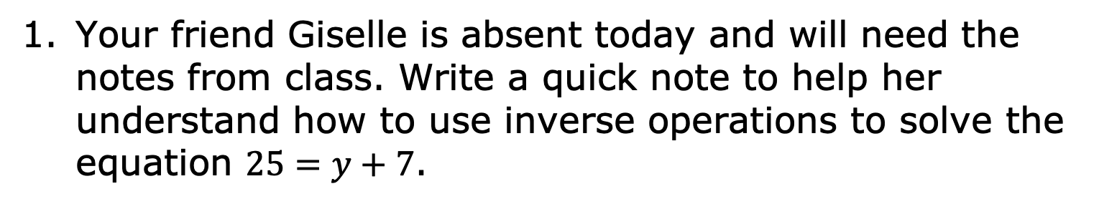
14.4.7 Wrap-Up: Cool Down
Your friend Giselle is absent today and will need the notes from class. Write a quick note to help her understand how to use inverse operations to solve the equation $25=y+7$.
volume 2, pg. 360

